Slide 1
Before and After Covid-19 – Norms and Social Distancing
Name
Institution
Course
Date

Slide 2
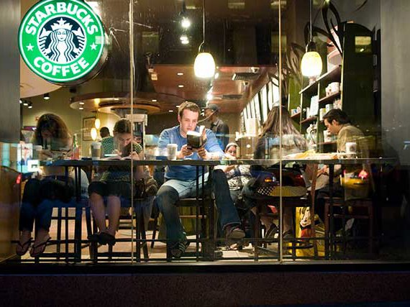
Before Covid-19
Notes:
Above is a photo taken in Starbucks, a famous coffee shop franchise with branches almost all over the world. The photo was taken before the Covid-19 pandemic which was first reported in 2019 in China before it spread to the United States of America in January (Bai et al, 2020). This was what our normal was before the pandemic hit.

Slide 3
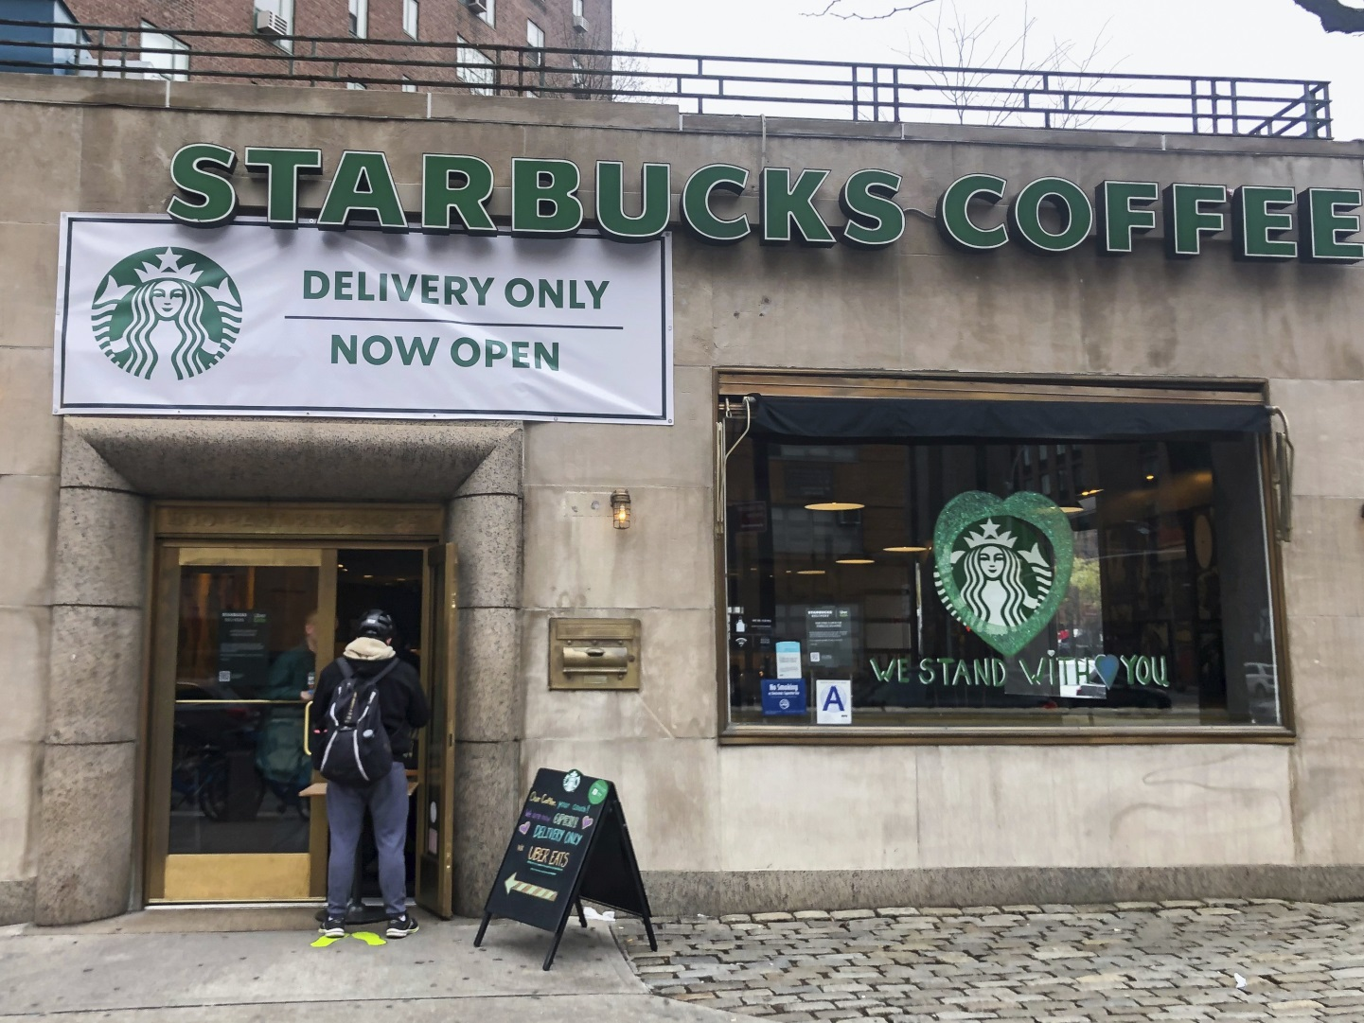
After Covid-19
Notes:
Covid-19 reached many nations by march 2020 forcing them to lockdown to try and reduce the spread of this disease. The above photo was taken after the lockdown restrictions were eased. Most businesses have opted to either do deliveries or get online in order to abide by the social distancing rule which was invoked due to the pandemic. This is our new normal because of the pandemic (Courtemanche et al, 2020).

Slide 4
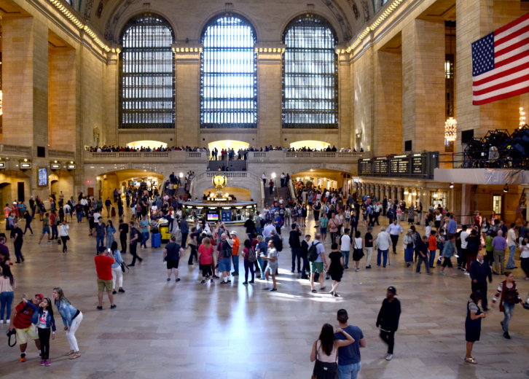
Before Covid-19
Notes:
Grand central terminal in New York city before the pandemic hit. Most people used this passage everyday to either get to work, run errands and this place was also an attraction site for tourists. People travelled from all over the world to see this place (Iverson & Barbier, 2020). Not only here but also other iconic places in the world.

Slide 5
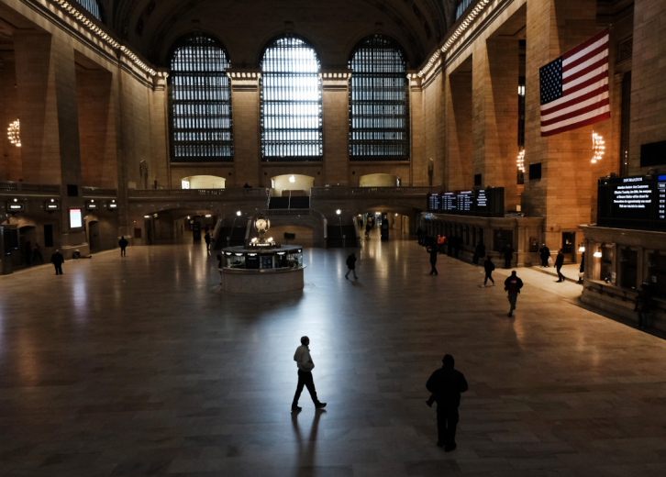
After Covid-19
Notes:
This is the terminal after the pandemic. Sometimes even empty because of the rules and regulations set to try and contain this disease. No tourists are allowed because of the restrictions set by the government. Keeping distance and avoiding crowds is a key step in avoiding infection and that is why our new normal as advised by medical professions is to self quarantine, sanitize and wear masks (Iverson & Barbier, 2020). Due to the pandemic, online is where everyone is, using social media apps to stay in touch with loved ones and even education has been going on online.

Slide 6
References
Bai, J. J., Jin, W., & Wan, C. (2020). The Impact of Social Capital on Individual Responses to COVID-19 Pandemic: Evidence from Social Distancing. Wang and Wan, Chi, The Impact of Social Capital on Individual Responses to COVID-19 Pandemic: Evidence from Social Distancing (May 23, 2020).
Courtemanche, C., Garuccio, J., Le, A., Pinkston, J., & Yelowitz, A. (2020). Strong Social Distancing Measures In The United States Reduced The COVID-19 Growth Rate: Study evaluates the impact of social distancing measures on the growth rate of confirmed COVID-19 cases across the United States. Health Affairs, 10-1377.
Iverson, T., & Barbier, E. (2020). National and Sub-National Social Distancing Responses to COVID-19.

